Slide 1

-: Mini Project :-
Topic – “Quests”
Yogesh Ahuja - 20ST114281001
Aaditya Gopalani - 20ST114281014
Shivani Patil - 20ST114281050
Aditya Patil - 20ST114281045

Slide 2

INTRODUCTION: -
We have to play a computer game called as Quest.
In this game the player will enter number of quest he/she want to complete, number of XP’s for each level and XP multiplier.
After that player will give input for quest i.e. number of xp of points and difficulty level for each quest.
After that the program will calculate the maximum number of XP’s that a player can earn for the input given by the player
(XP = Experience Points)

Slide 3
OBJECTIVE : -
The main objective of Quest game is –
To achieve a perfect playthrough.
To find maximum of XP’s(Experience Points) from the give input by the player.
To complete any quest, regardless of its target difficulty level.
To complete all the quests in an order that will allow you to earn the largest possible number of XPs.

Slide 4
Example
Sample Input 1 | Sample Output 1
3 10 2 | 43
1
2
9 1

Slide 5
Example :-
In the sample input, the maximum XPs you can earn is 43, which is done as follows.
First complete the second quest (you earn 4 XPs, because you are at level 0, and you completed a quest with target difficulty level 2).
Then complete the first quest (you earn 30 XPs, because you are still at level 0, and the target difficulty level is 1).
With 34 XPs, you are now level 3.
Finally, complete the third quest (for which you earn 9 XPs, without the multiplier, since you are already at level 3).

Slide 6
LITREATURE SURVEY : -
Sorting Algorithms:-
https://www.geeksforgeeks.org/sorting-algorithms/
Quests:-
https://en.wikipedia.org/wiki/Quest
Experience Points:-
https://en.wikipedia.org/wiki/Experience_point

Slide 7
METHODOLOGY :-
Modules :
Take inputs – NumberOfQuests(n), ExperiencePoints(v), XpMultiplier(c):
The all the necessary inputs from the player-n, v and c.
Deadline:
Sort all the inputs according to the deadline
(xp*XpMultiplier + DifficultyLevel*ExperiencePoints) in ascending order.
Maximum ExperiencePoints:
Complete the quest one by one and give the output i.e. Maximum number of Experience Points that a player can earn.

Slide 8
b) Algorithm:-
Step 1:- Create a structure for quest with properties-Experience points, target difficulty level and deadline.
Step 2:- Create array of structure quest.
Step 3:- Create a function for comparison.
Step 4:- Declare variables for CurrentLevel and MaximumXp and initialize to zero.
Step 5:- Take inputs for NumberOfQuests(n), ExperiencePoints(v), XpMultiplier(c).
Step 6:- According to the value of n take inputs for quest i.e. xp and target difficulty level of that quest.
Step 7:- Calculate deadline = (xp * c) + (target * v)
Step 8:- Sort the array of structure quest.
Step 9:- Create loop according to the value of n and complete the quest.
Step 10:- if CurrentLevel is less than target difficulty level of that quest then multiply xp of that quest with the xp multiplier(c) and add to the MaximumXp variable.
Step 11:- If CurrentlLevel is greater than or equal to target difficulty level of that quest then directly add xp to the MaximumXp variable.
Step 12:- Print the value of MaximumXp variable.

Slide 9
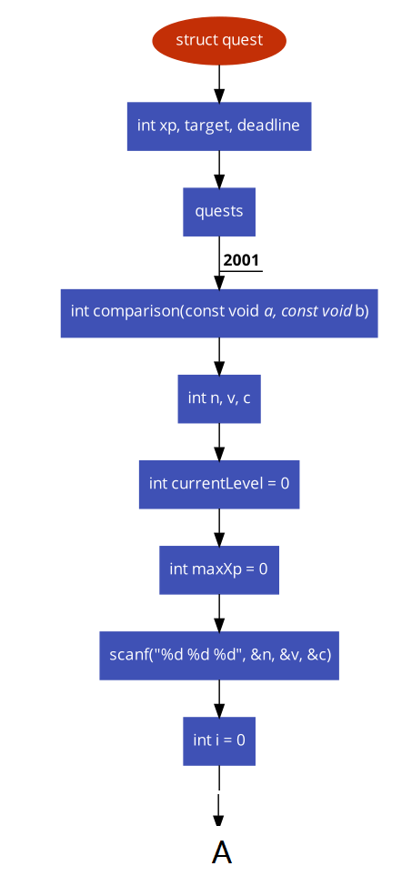
c) Flowchart:-

Slide 10
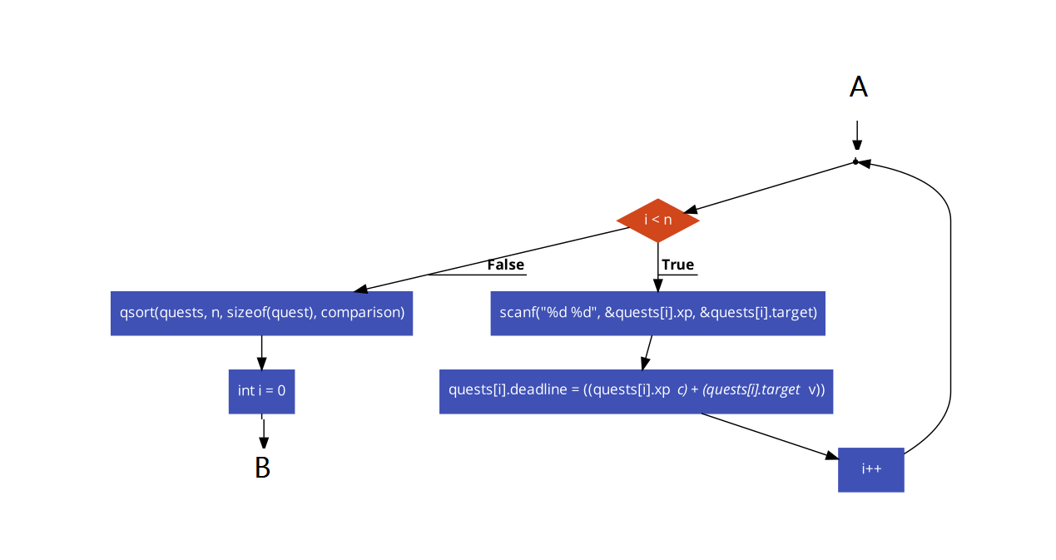

Slide 11
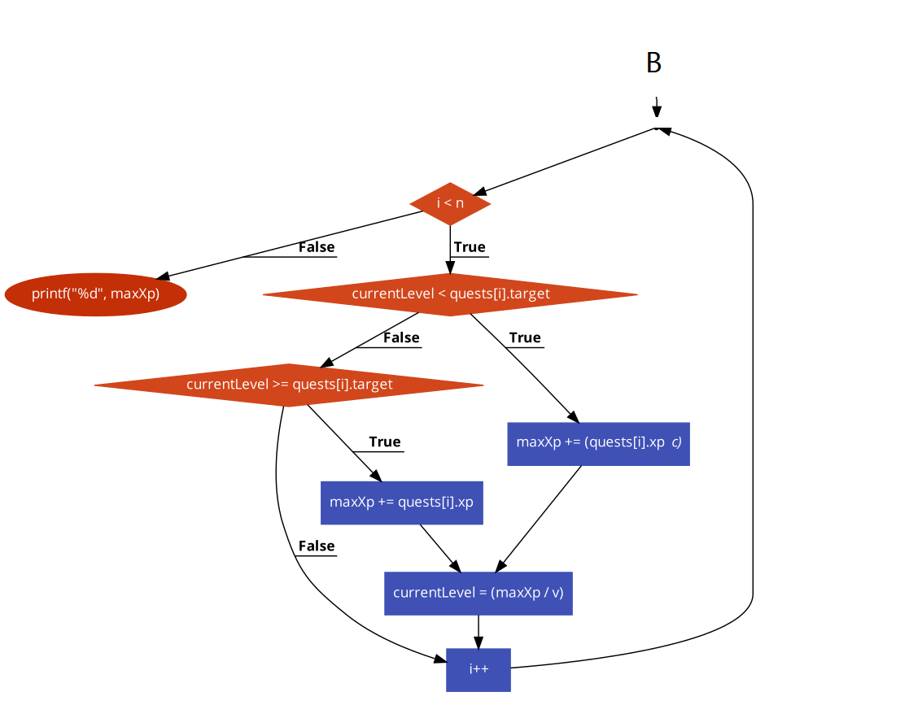

Slide 12
Input And Output
Input 2 | Output
2 20 3 | 45
1
9 2
Input 3 | Output
4 15 2 | 160
1
2
30 3
4

Slide 13

TECHNOLOGY DESCRIPTION : -
We will be implementing this problem statement in C language. :-

Slide 14
ADVANTAGES : -
We will be able to find maximum number of xp’s(experience points) for the input given by the player/user.
Perfect playthrough.

Slide 15
REQUIREMENTS : -
Software requirements:
C compiler
Hardware requirement:
Processor Intel i3/i5/i7
RAM minimum 4 GB
Hard disk minimum 15 GB
internet connection

Slide 16
REFERENCE: -
https://icpc.global/worldfinals/problems/2020+ACM-ICPC+World+Finals/icpc2020.pdf
https://www.geeksforgeeks.org/sorting-algorithms/
https://en.wikipedia.org/wiki/Quest
https://en.wikipedia.org/wiki/Experience_point

Slide 17


